Slide 1
Epipolar
Introduction to Computer Vision
Prof. Tom Yeh

Slide 2
Motivation

Slide 3


Two DVDs and Two cameras

Slide 4


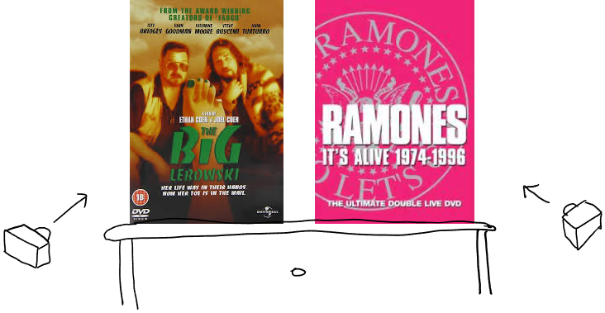
What do the cameras see?
Photo Credit: RD Milligan

Slide 7



Slide 8
________ u + __________ v + ___________ = 0

Slide 9
Basic Components of Epipolar Geometry

Slide 10
Epipolar Geometry
Identify left camera
Identify right camera
Identify the virtual image plane of left camera
Identify the virtual image plane of the right camera
P₁
P₂
P₃
⦻
⦻

Slide 11
Projections on virtual image planes
Identify a₁ = P₁ ↓ A
Identify a₂ = P₂ ↓ A
Identify a₃ = P₃ ↓ A
Identify b₁ = P₁ ↓ B
Identify b₂ = P₂ ↓ B
Identify b₃ = P₃ ↓ B
Compare a_{1 ___} a_{2 ___} a₃
Compare b_{1 ___} b_{2 ___} b₃
P₁
P₂
P₃
A
B
⦻
⦻
⦻
⦻
O_{l}
⦻
⦻
O_{r}

Slide 12
Epipoles
Identify the left epipole e_{l} = __ ↓ __
Identify the right epipole e_{r} = __ ↓ __
P₁
P₂
P₃
A
B
⦻
⦻
⦻
⦻
O_{l}
⦻
⦻
O_{r}

Slide 13
Epipolar Line
Draw the epipolar line containing a₁, a₂, a_{3,} e_{left}
P₁
P₂
P₃
A
B
⦻
⦻
⦻
⦻
O_{l}
⦻
⦻
O_{r}

Slide 14

Two epipolar planes
Identify the epipolar plane P₁,P₁,P₃ are on
Identify the epipolar plane P₄,P₅ are on
Compare P_{1,y} ___ P_{4,y}
Compare P_{5,y} ___ P_{3,y}
P₁
P₄
P₂
P₅
P₃
A
B
⦻
⦻
⦻
⦻
⦻
O_{l}
⦻
⦻
O_{r}

Slide 15
Two epipolar lines
Identify b₄ = P₄ ↓ B
Identify b₅ = P₅ ↓ B
Identify e_{l} = __ ↓ __
Identify a₁ = P₁ ↓ A
Draw a₄ = P₄ ↓ A
Draw a₅ = P₅ ↓ A
Draw the epipolar line a₁ is on
Draw the epipolar line a₄, a₅ are on
P₁
P₄
P₂
P₅
P₃
A
B
⦻
⦻
⦻
⦻
⦻
O_{l}
⦻
⦻
O_{r}

Slide 16
Epipolar Constraint

Slide 17
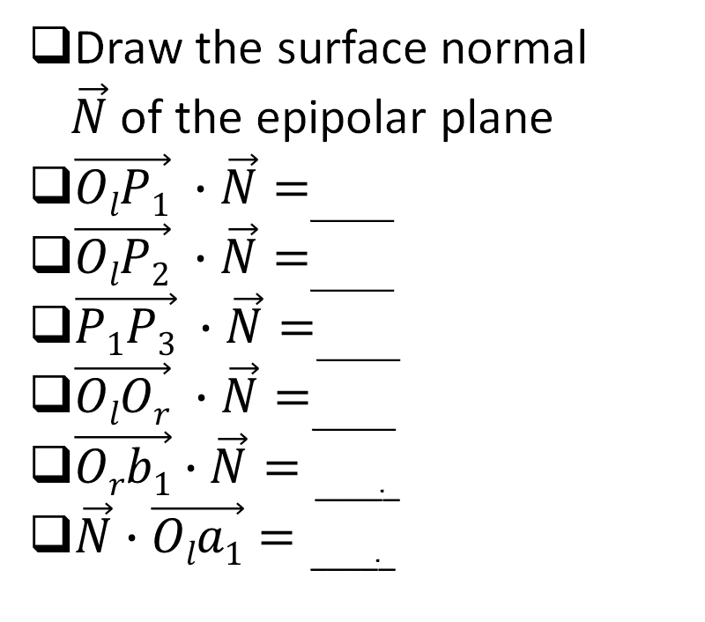
Surface normal of an epipolar plane
Draw the surface normal $\vec{N}$of the epipolar plane
$\vec{OlP1} ∙\vec{N}=$_____
$\vec{OlP2} ∙\vec{N}=$_____
$\vec{P1P3} ∙\vec{N}=$_____
$\vec{OlOr} ∙\vec{N}=$_____
$\vec{Orb1}∙\vec{N}=\text{_____}$
$\vec{N}∙\vec{Ola1}=\text{_____}$
P₁
P₂
P₃
A
B
⦻
⦻
⦻
⦻
O_{l}
⦻
⦻
O_{r}

Slide 18
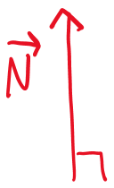
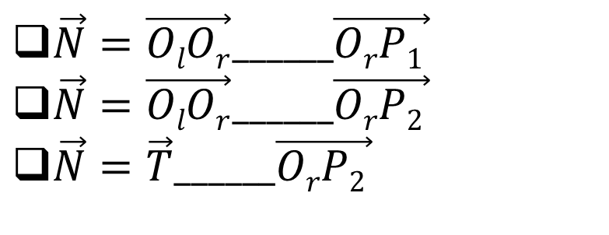
Calculate surface normal
$\vec{N}=\vec{OlOr}______\vec{OrP1 }$
$\vec{N}=\vec{OlOr}______\vec{OrP2 }$
$\vec{N}=\vec{T}______\vec{OrP2 }$
P₁
P₂
P₃
A
B
⦻
⦻
⦻
⦻
O_{l}
⦻
⦻
O_{r}

Slide 19
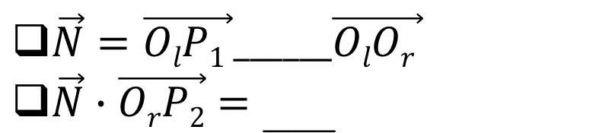
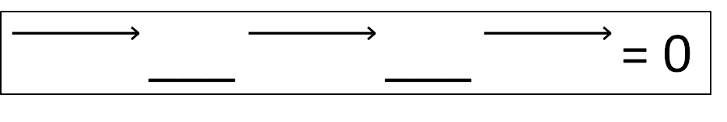
Epipolar Constraint on P₁ and P₂ (coplanar)
$\vec{N}=\vec{OlP1 }______\vec{OlOr }$
$\vec{N}∙\vec{OrP2}=\text{_____}$
P₁
___ ___ = 0
P₂
P₃
A
B
⦻
⦻
⦻
⦻
O_{l}
⦻
⦻
O_{r}

Slide 20
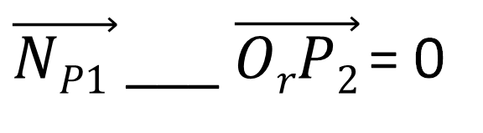
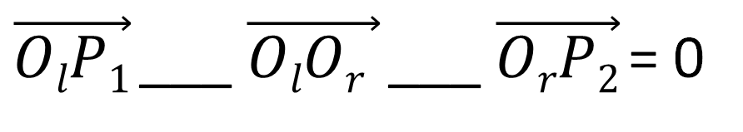
Derive the epipolar constraint equation
$\vec{OlP1}$___ $\vec{OlOr }$___ $\vec{OrP2}$= 0
$\vec{NP1 }$___ $\vec{OrP2}$= 0

Slide 21
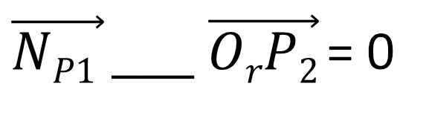
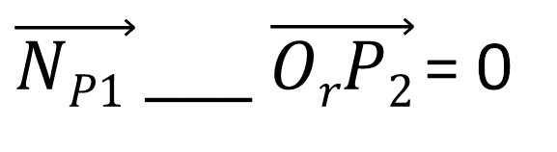
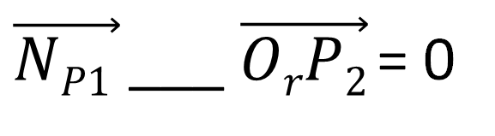
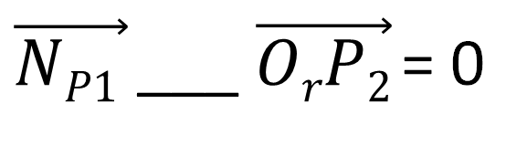
Must use the same coordinate system
$\vec{NP1 }$___ $\vec{OrP2}$= 0
$\vec{NP1 }$___ $\vec{OrP2}$= 0
$\vec{NP1 }$___ $\vec{OrP2}$= 0
$\vec{NP1 }$___ $\vec{OrP2}$= 0

Slide 22
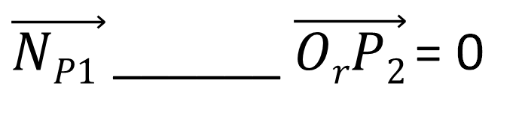
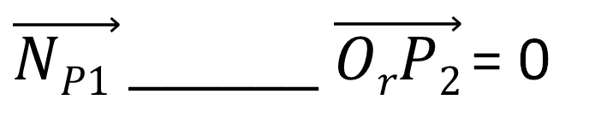
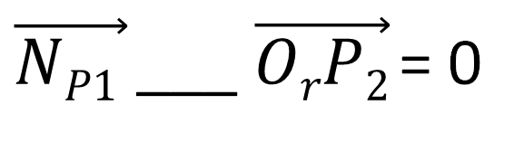
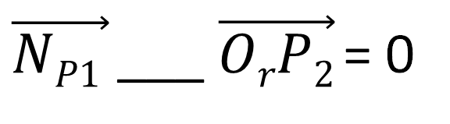
Connect the left and right views
$\vec{NP1 }$______ $\vec{OrP2}$= 0
$\vec{NP1 }$___ $\vec{OrP2}$= 0
$\vec{NP1 }$______ $\vec{OrP2}$= 0
$\vec{NP1 }$___ $\vec{OrP2}$= 0

Slide 23
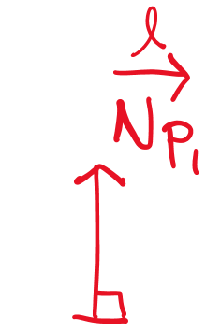
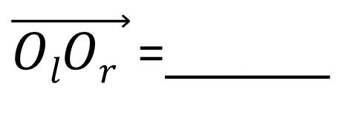
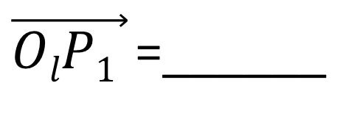
Left camera coordinate system
P₁
$\vec{OlP1 }$=______
P₂
O_{r}
B
$\vec{OlOr }$=______
A
⦻
⦻
O_{l}

Slide 24
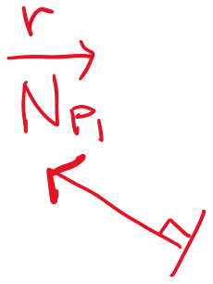
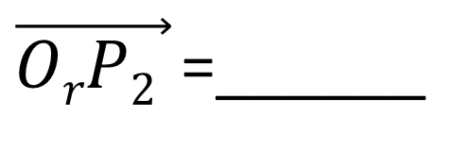
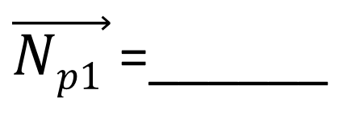
Right camera coordinate system
$\vec{OrP2 }$=______
P₁
P₂
$\vec{Np1 }$=______
B
⦻
O_{r}

Slide 25
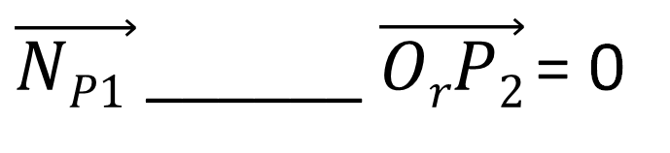
Put everything together
$\vec{NP1 }$______ $\vec{OrP2}$= 0

